Slide 1
Workshop:
When is a Biomarker Ready for Use in a Clinical Trial
2024 New Investigators Clinical Trial Course
August 22, 2024
Scott Bratman, MD PhD
Tricia Cottrell, MD PhD

Slide 2
Disclosures – Bratman
Employment Relationships:
University Health Network: Staff Radiation Oncologist – Clinician-Scientist
Adela: Co-Founder and Chief Innovation Officer
Consulting or Advisory Board/Speaker/Faculty/Research/Honoraria:
EMD Serono: Advisory Board
Ownerships/Investments/Intellectual Property:
Adela: Licensed patents, stock
Roche: Licensed patent

Slide 3
Disclosures – Cottrell
None

Slide 4
Learning Objectives
1. Describe the approval process for drugs and biomarkers
2. Discuss how clinical trial design impacts the adoption of biomarkers in clinical practice
3. List key features of biomarker assessment that can impact their use in a clinical trial

Slide 5
Case Studies

Slide 6
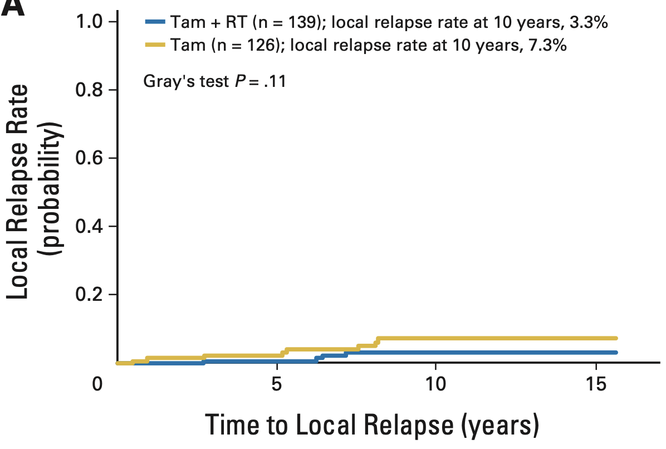
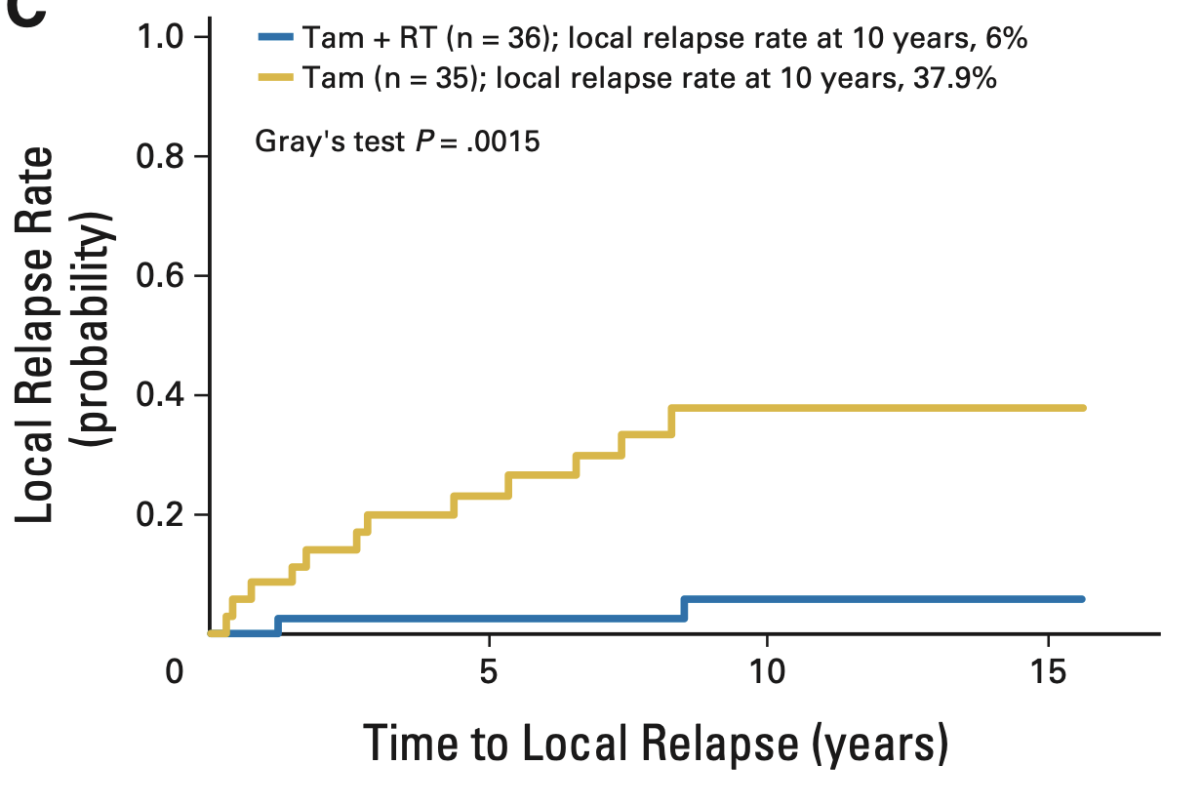
Case Study 1
T1N0 Luminal A Breast Cancer
T1N0 HER2+ and TNBC
Liu FF, Fyles T, et al. JCO 2015;33(18):2035-40

Slide 7
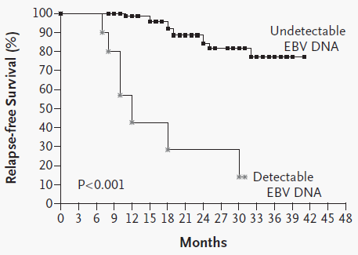
Case Study 2
Post-Treatment Plasma EBV DNA in NPC
N Engl J Med; 2004, 350:2461-2470

Slide 8
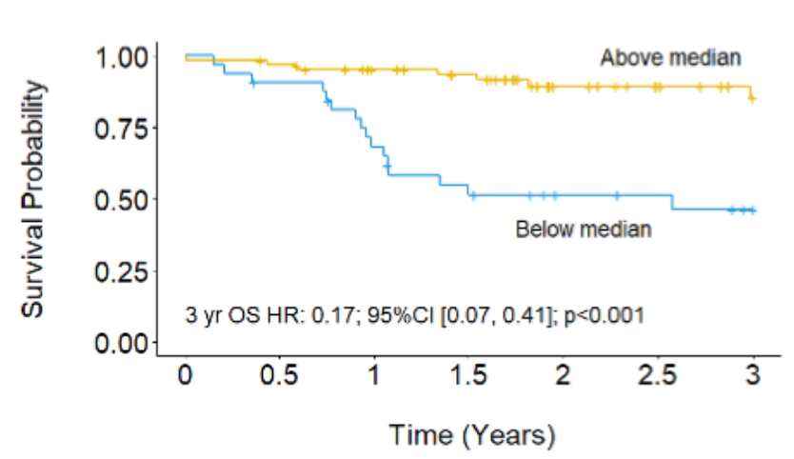
Case Study 3
Infiltrating CD19+ B cells in HPV+ HNSCC
Kim, Sharabi, et al, CCR 2020

Slide 9
“Biomarker” vs “Assay” vs “Test”
Biomarker: Characteristic that is objectively measured as an indicator of a biologic processes or a responses to a therapeutic intervention
Assay: Method for determining the presence or quantity of a component
Test: Procedure that makes use of an assay for a particular purpose

Slide 10
Examples of Biomarkers
Setting | Biomarker
Risk of developing cancer | BRCA carrier Clonal hematopoiesis
Early detection & diagnosis | Cologuard
Prognosis | Oncotype Dx Circulating tumor cells HPV in head & neck ca
Predictive of treatment benefit or harm | ER/PR HER2 ARv7 WT KRAS
Monitor disease burden | PSA ctDNA
Surrogate endpoint for efficacy | PET PSA
Therapeutic Biomarkers

Slide 11
A Renaissance of Biomarker Research
Tissues
(Normal & Malignant)
Biofluids
(Blood, Urine, etc.)
Imaging
(Anatomic, Functional, etc.)
Tumour Cells
(Primary & metastasis)
Host (Normal) Cells
(Healthy tissues)
Tumour Microenvironment
(Vasculature, immune infiltrates, etc.)
MEDIUM
SOURCE
New Technologies
(DNA sequencing, etc.)
Clinical Trials
(Improved infrastructure)
Relevant Endpoints
(Efficacy, toxicity, QOL, cost, etc.)
ENABLERS

Slide 12
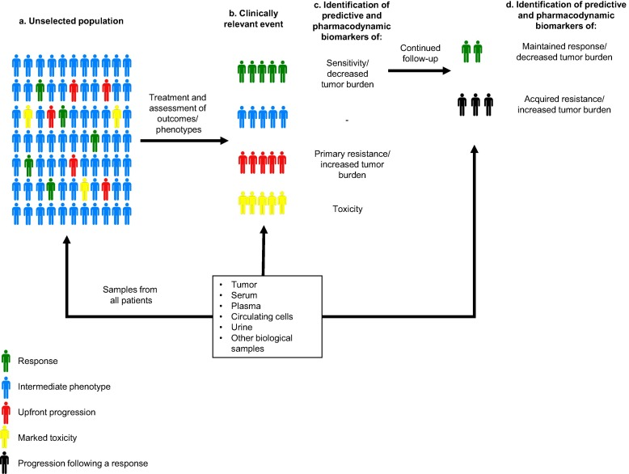
Biomarker Discovery Framework for Clinical Research
Perez-Gracia et al., 2017, Cancer Treatment Reviews, 53:79-97

Slide 13
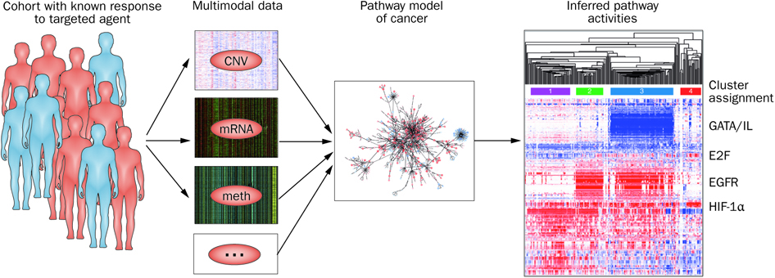
Multi-Omics for Biomarker Discovery
Collisson, E. A. et al. (2012) Nat. Rev. Clin. Oncol

Slide 14
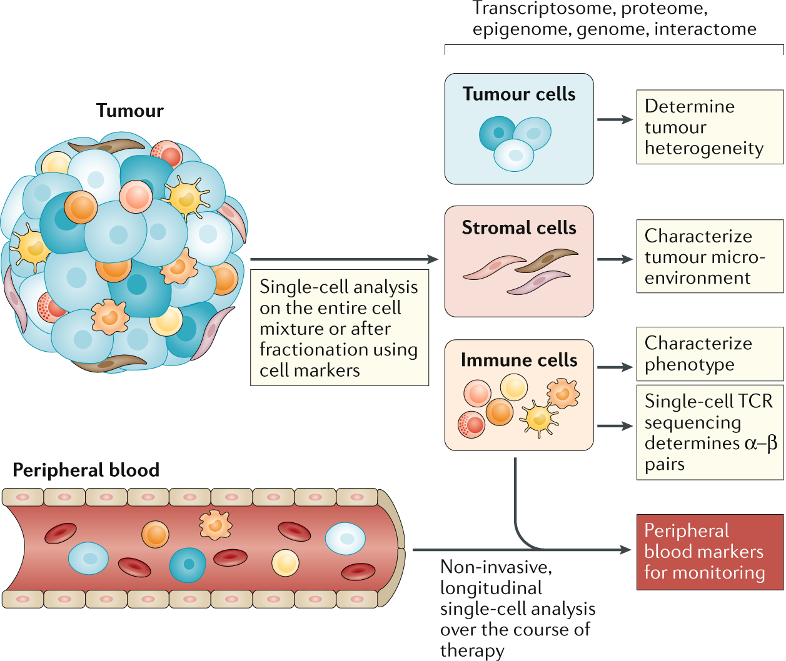
Deep Profiling of Individual Cells
Gohill et al. (2021) Nat. Rev. Clin. Oncol

Slide 15
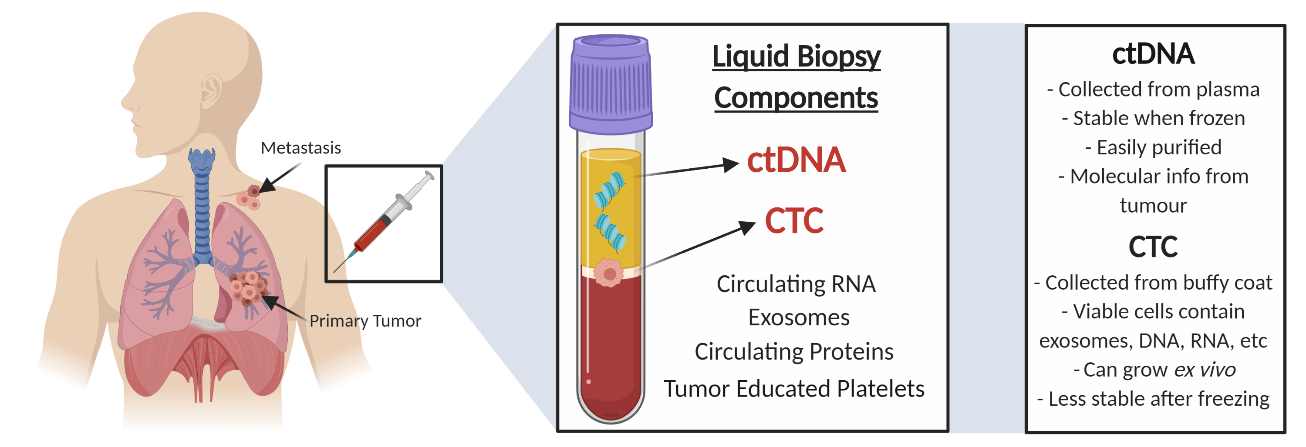
Blood-based (“Liquid Biopsy) Biomarkers
De Michino, Lok, Bratman et al. IJROBP 2020; 107(5),873-886

Slide 16
Prognostic vs Predictive Biomarkers
Prognostic biomarker: provides information on the likely course of the cancer disease in an untreated/similarly treated individual(s).
Predictive biomarker: can be used to identify subpopulations of patients who are most likely to respond to a given therapy.
Test treatment
Standard
Sensors; 2012, 12:8966-8986

Slide 17
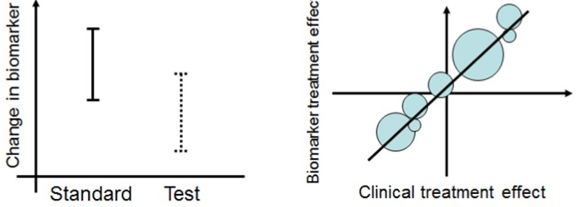
Pharmacodynamic Biomarkers & Surrogate Endpoints
Pharmacodynamic
Biomarker
Surrogate
Endpoint
Sensors; 2012, 12:8966-8986

Slide 18
Path to Validation of Biomarkers
Analytical validation
  Compare to gold standard to determine repeatability, accuracy, robustness, etc.
Clinical validation
  What are the associations of the biomarker with clinical endpoints (e.g., survival, toxicity, etc.)
Clinical utility
  Does use of the biomarker result in patient or societal benefits
  Depends on clinical context/use of the biomarker

Slide 19
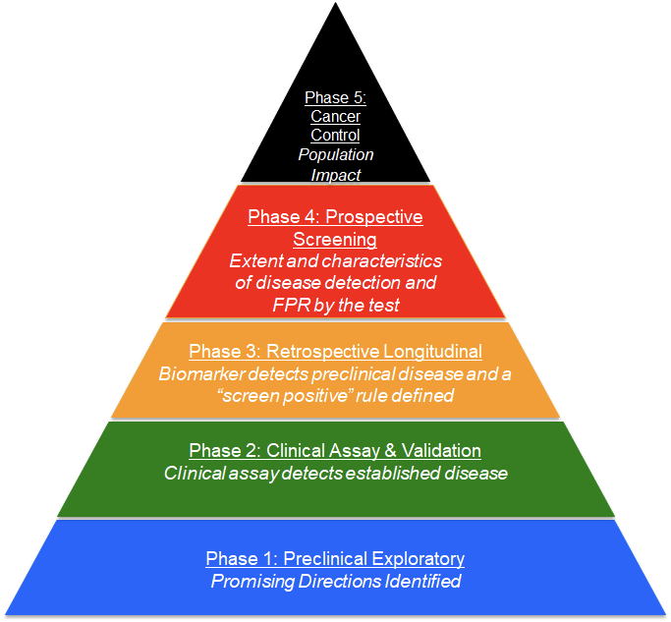
Validation of Early Detection Biomarkers: Five-Phase Approach
Edrn.nci.nih.gov

Slide 20
Biomarkers in Clinical Trials
Phase 1 studies:
  Pharmacodynamics biomarkers (usually exploratory)
Phase 2/3 studies:
  Exploratory vs. Integrated vs Integral
  Mandatory vs Optional

Slide 21
Prospective Designs to Demonstrate Biomarker Utility
  Target selection (enrichment) designs
  Biomarker by treatment interaction designs (biomarker stratified design)
  Biomarker-strategy designs
  Adaptive designs

Slide 22
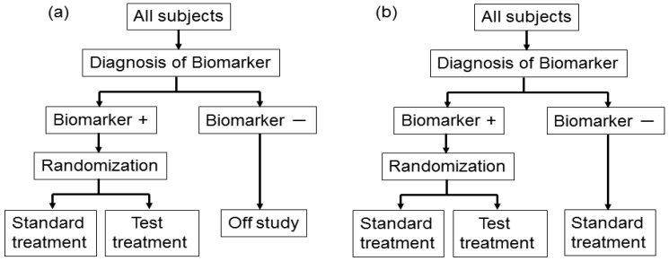
Enrichment designs
Sensors; 2012, 12:8966-8986

Slide 23
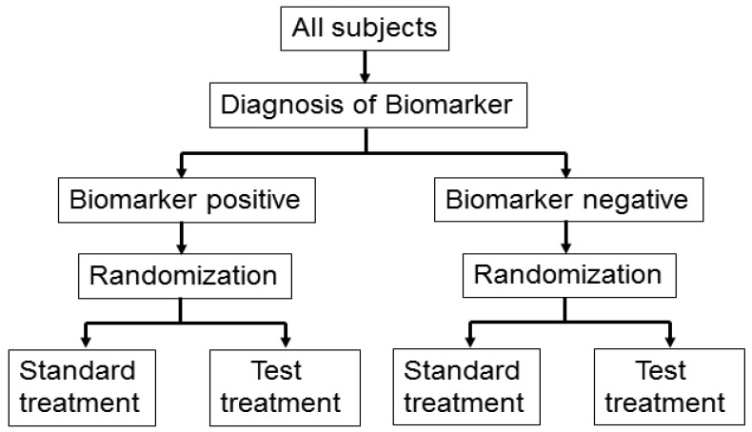
Biomarker by treatment interaction design
Sensors; 2012, 12:8966-8986

Slide 24
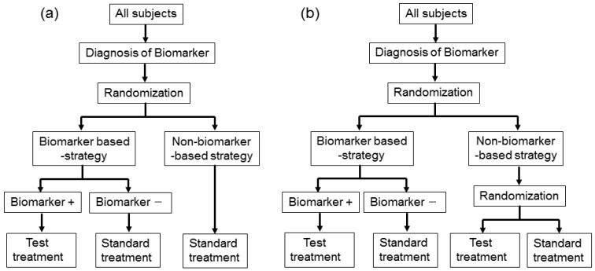
Biomarker-strategy designs
Sensors; 2012, 12:8966-8986

Slide 25
Challenges & Limitations of Biomarkers in Clinical Trials
Inappropriate study design (e.g., insufficient numbers, lack of relevant data)
Inappropriate study execution (e.g., poor SOPs, variable collection)
Loss of pragmatism in clinical trial design (drag on accrual, etc.)
Cost and complexity of sample collection and storage
Longevity of samples in storage
Robustness of techniques across labs
Turn-around-time required for results

Slide 26
Case Studies

Slide 27
Case Study 1
T1N0 Luminal A Breast Cancer
T1N0 HER2+ and TNBC
Liu FF, Fyles T, et al. JCO 2015;33(18):2035-40

Slide 28
Case Study 2
Post-Treatment Plasma EBV DNA in NPC
N Engl J Med; 2004, 350:2461-2470

Slide 29
Case Study 3
Infiltrating CD19+ B cells in HPV+ HNSCC
Kim, Sharabi, et al, CCR 2020

